Slide 1
Debt Collection
City of Tshwane
Andrew Hanson - UP
Sinawo Dlulisa- Wits
Smangaliso Mnguni- Unizulu
Sinegugu Mazibuko – UP
Mentor: Tshepiso Mokoena

Slide 2
Introduction
City of Tshwane has a major debt collection problem
Companies and Individuals accumulate debt
Electricity or water gets cut-off
This incurs a penalty fee in someway or another

Slide 3
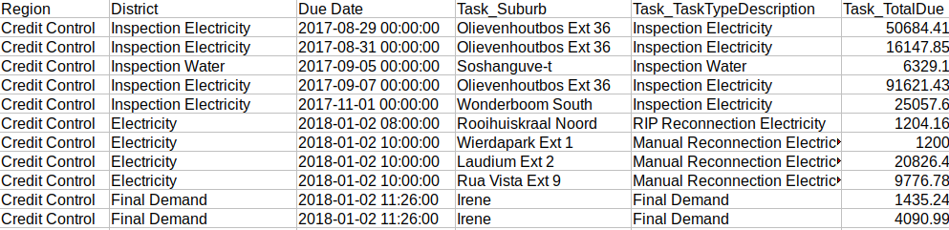
Data

Slide 4
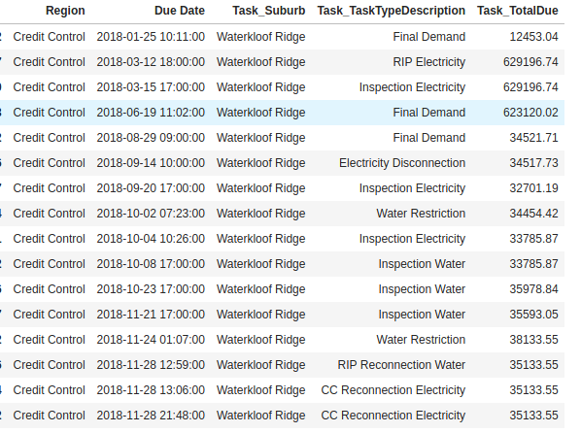

Slide 5
Methods
Data Cleaning
General Analysis
Visualization using QGIS
Word Cloud

Slide 6
Data Cleaning
Removing Blanks
Convert text to integer for processing
Remove duplicates
Highlight errors
Identification of missing account numbers

Slide 7
General Analysis
Understanding the task descriptions
5 number summary
Following a particular individual month to month
Calculating total debt incurred in 2018

Slide 8
Five Number Summary
Mean Total Due": R46 720.39
Standard deviation Total Due: R149 856.10
Minimum: R 0 (less than 1 standard deviation from the mean)
Maximum:R 23 402 990 (more than three standard deviations from the mean (outlier))
Quantiles: Q1: R4 357.97
Q2: R11 110.96
Q3: R40 458.10

Slide 9
Results
Total Debt Incurred over 2018
Total disconnections per Area
Total amounts owed per Area
Electricity disconnections per area
Total amounts owed in the worst performing area
Top 10 individual who owe the most

Slide 10
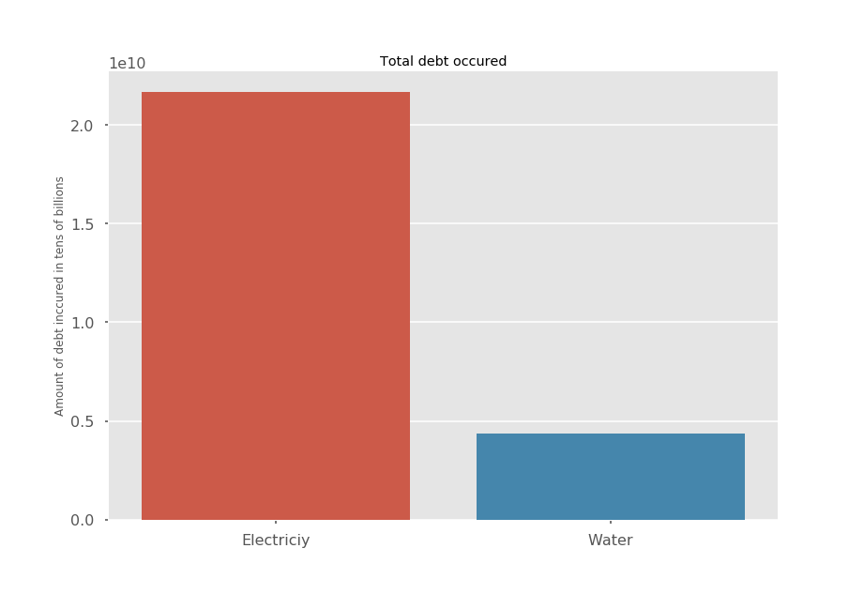

Slide 11
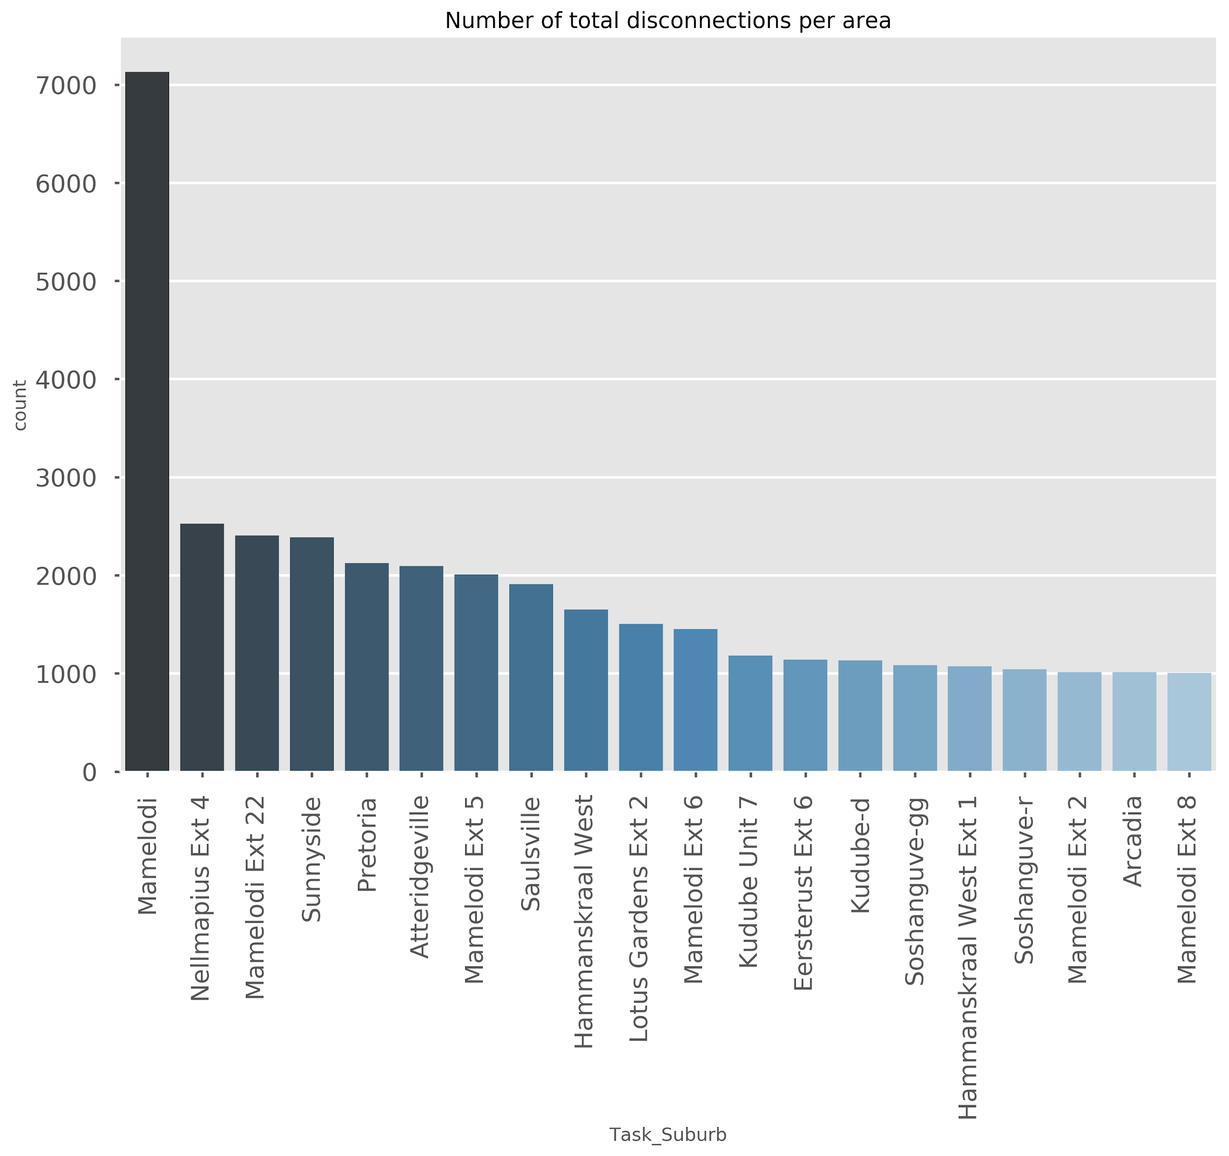

Slide 12
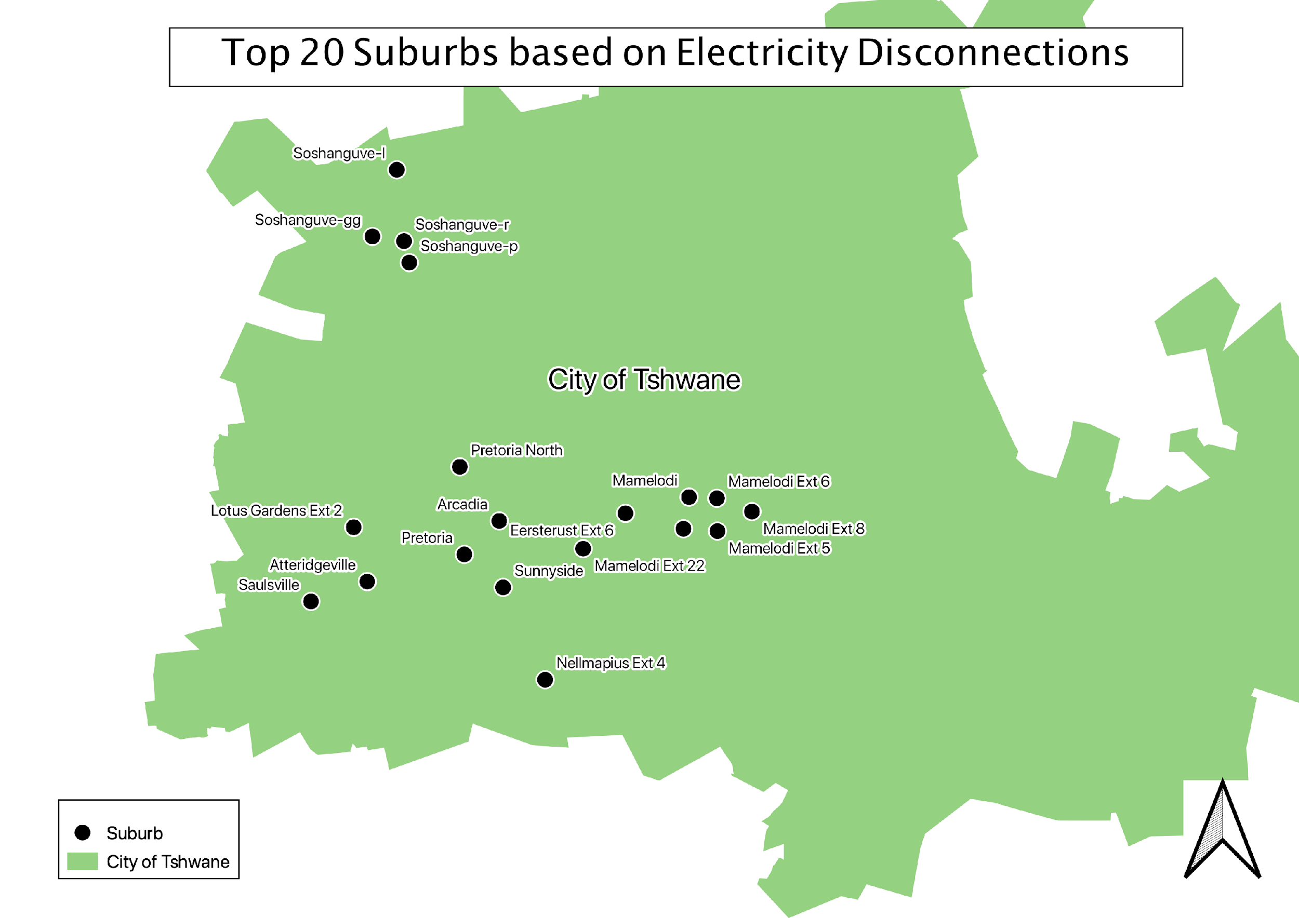

Slide 13
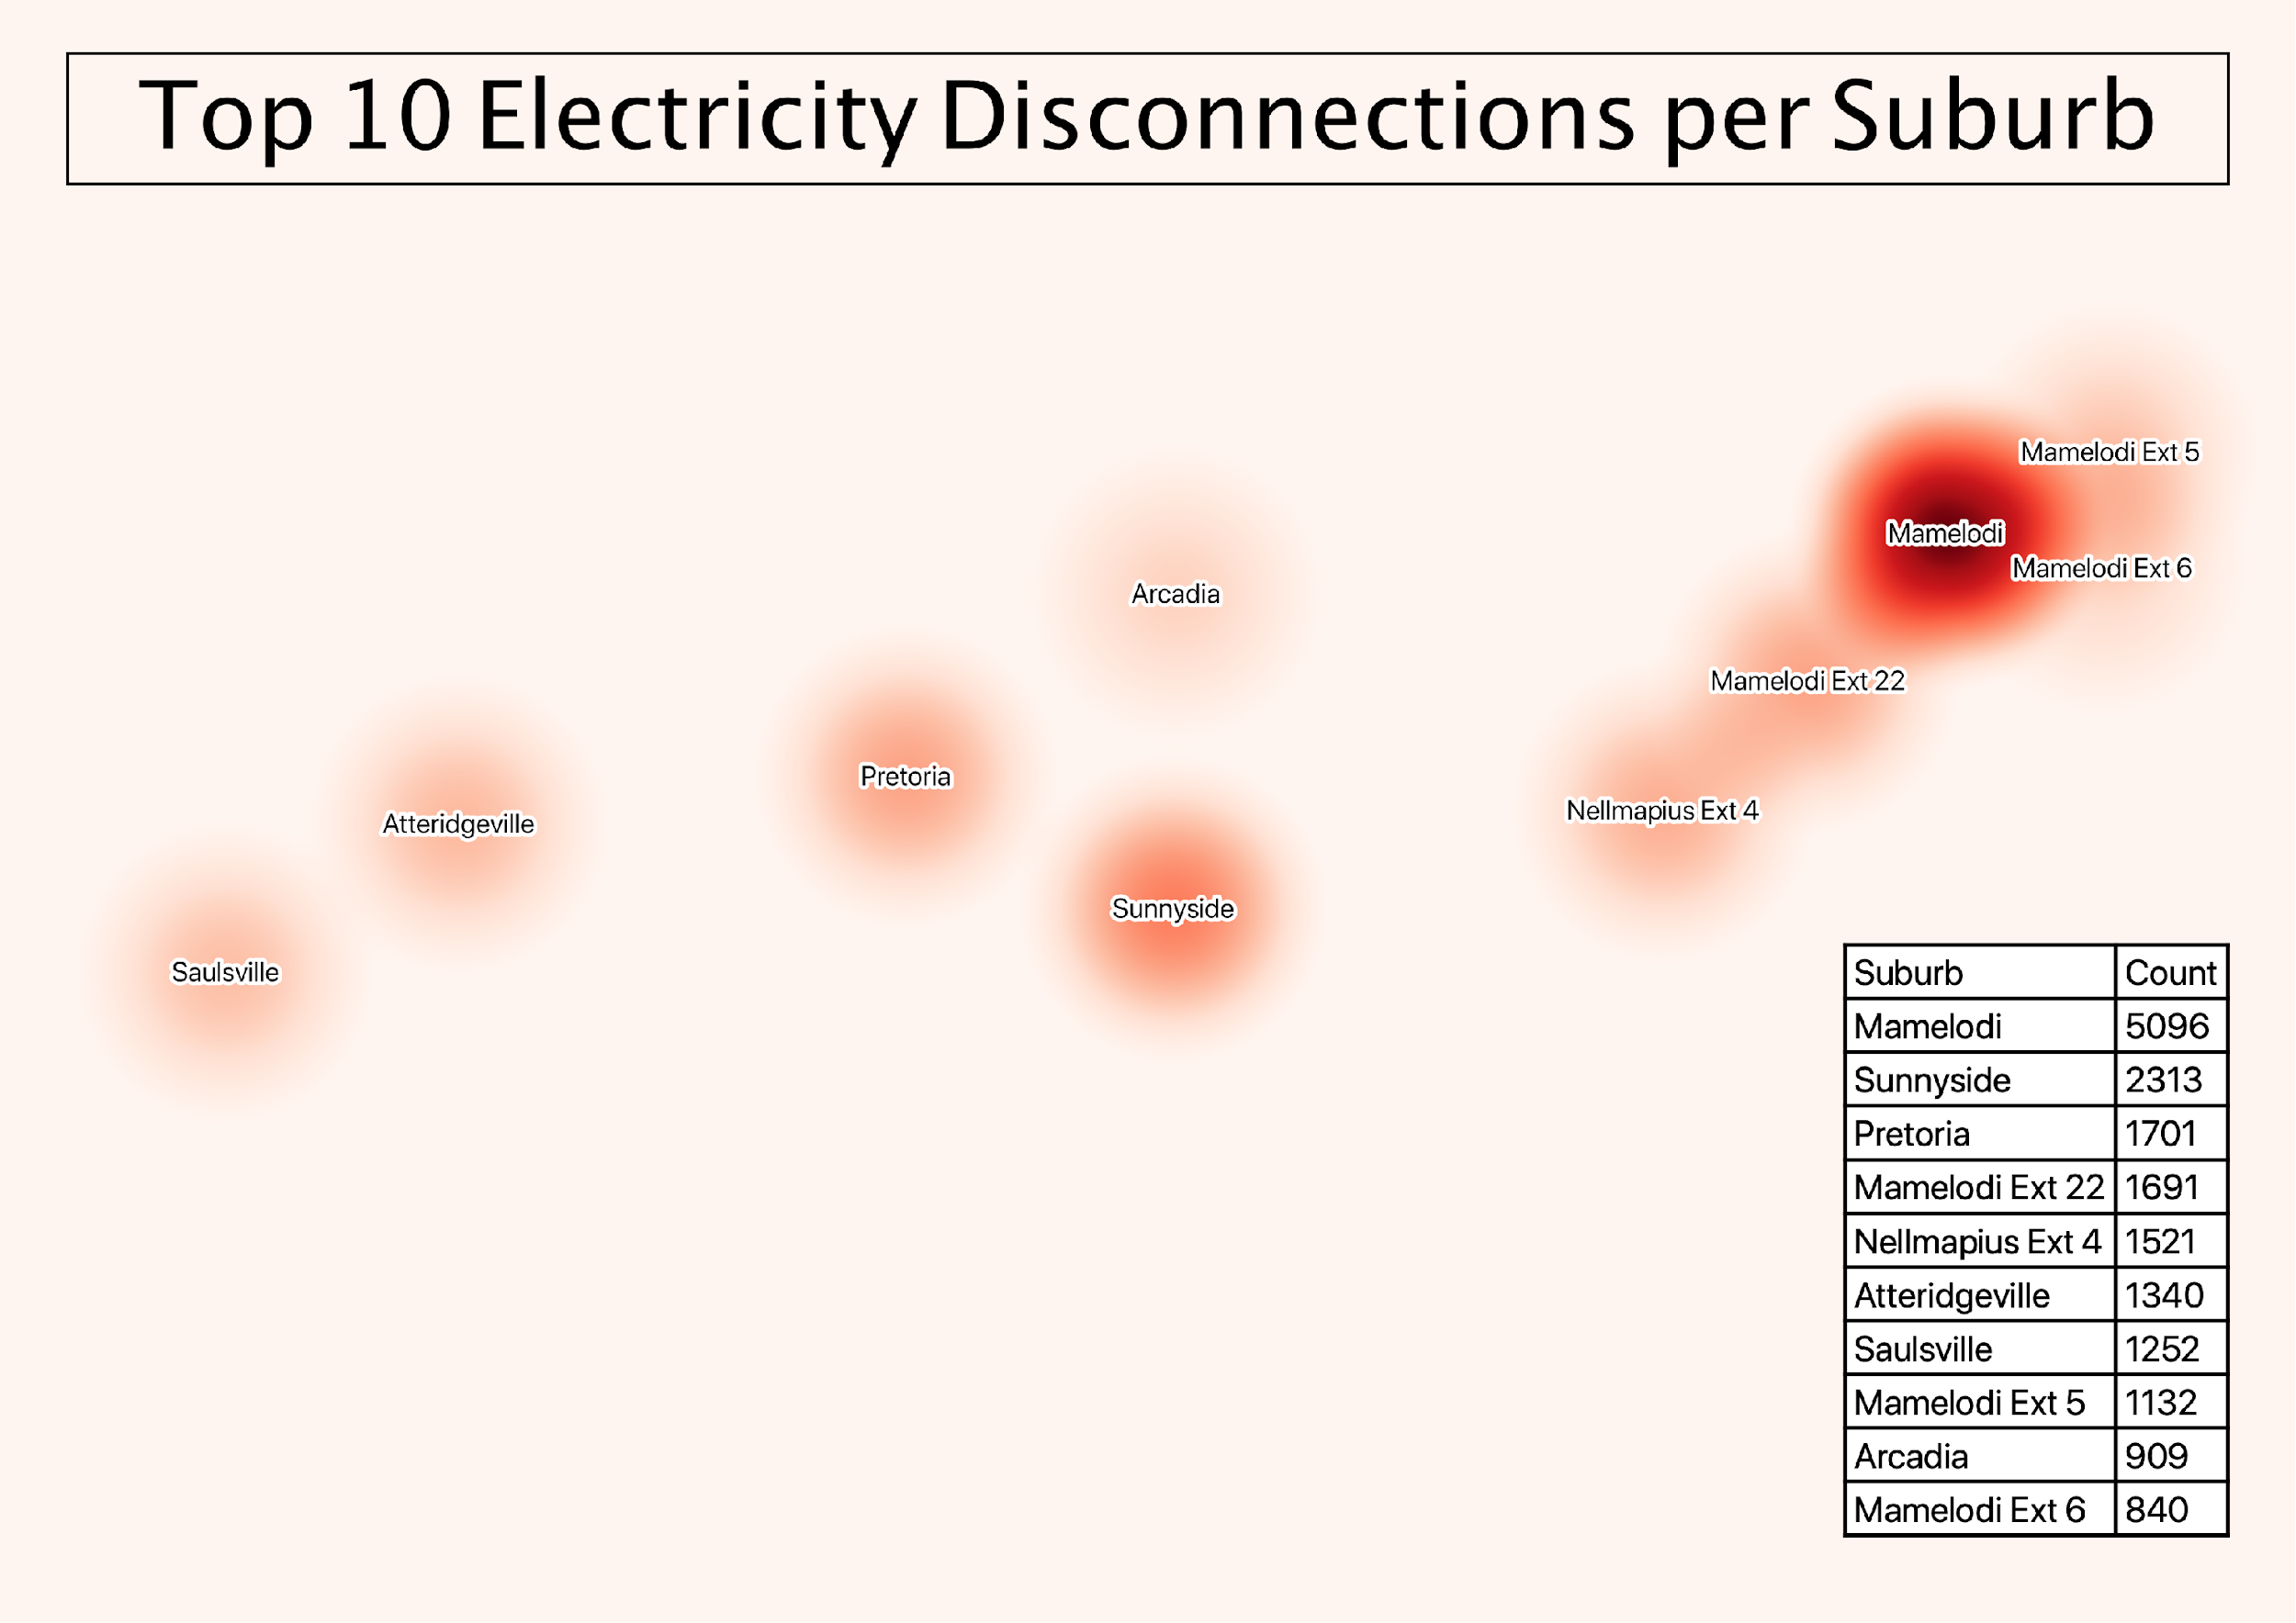

Slide 14
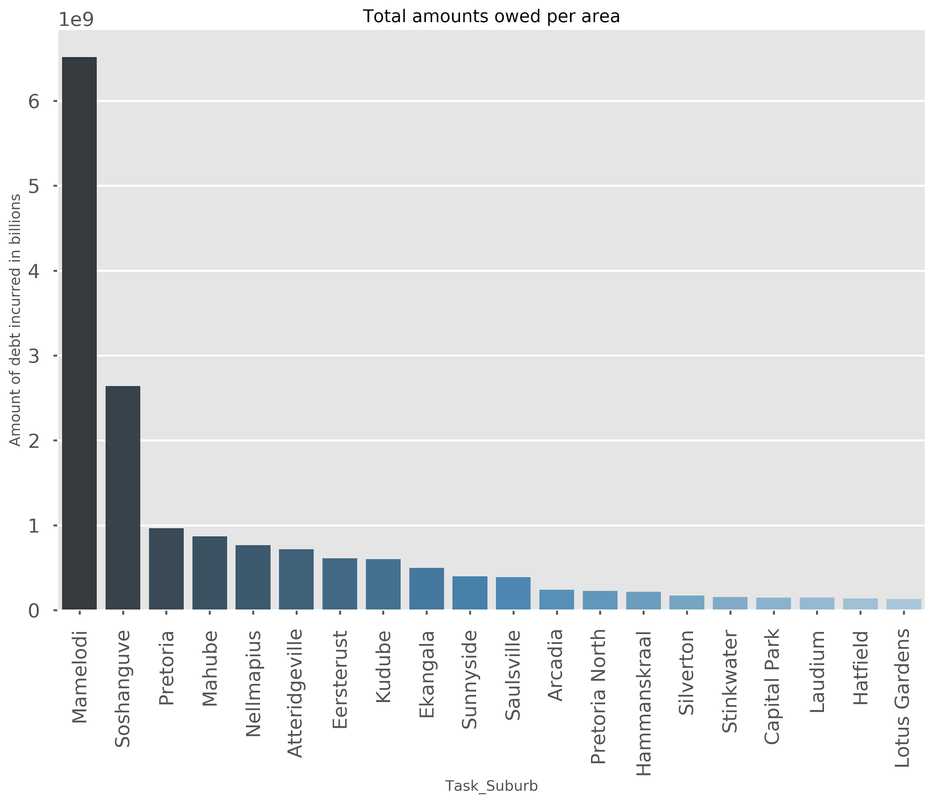

Slide 15
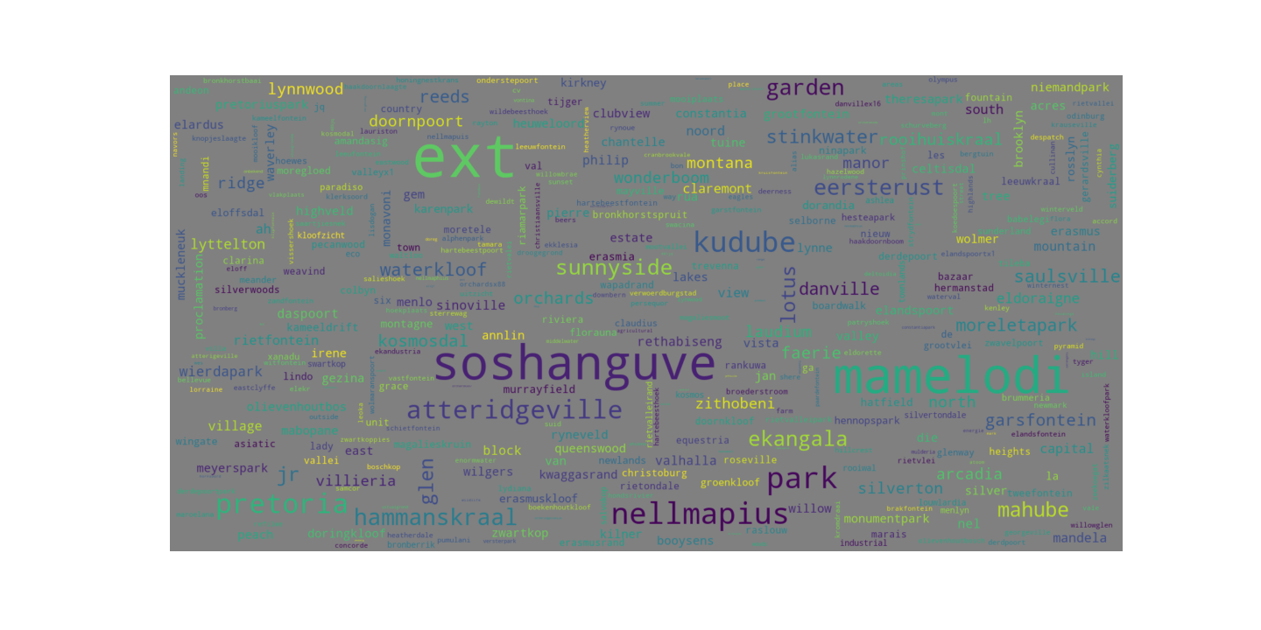
1

Slide 16
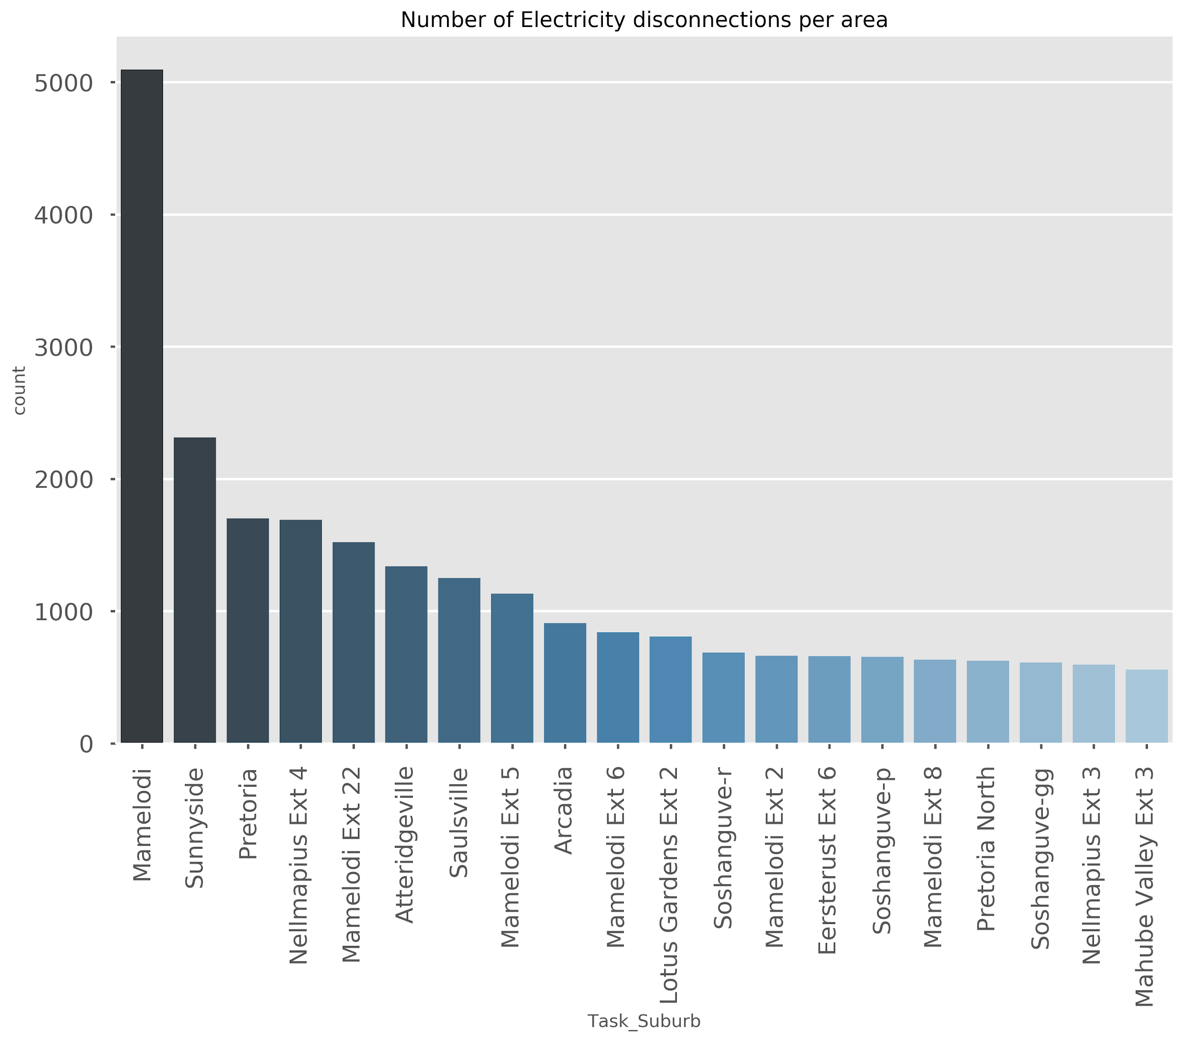

Slide 17
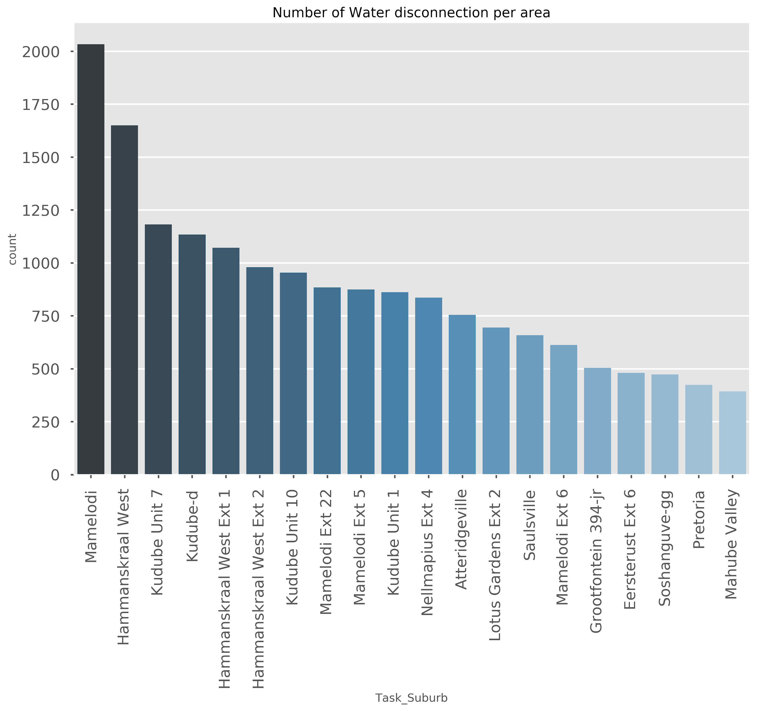

Slide 18
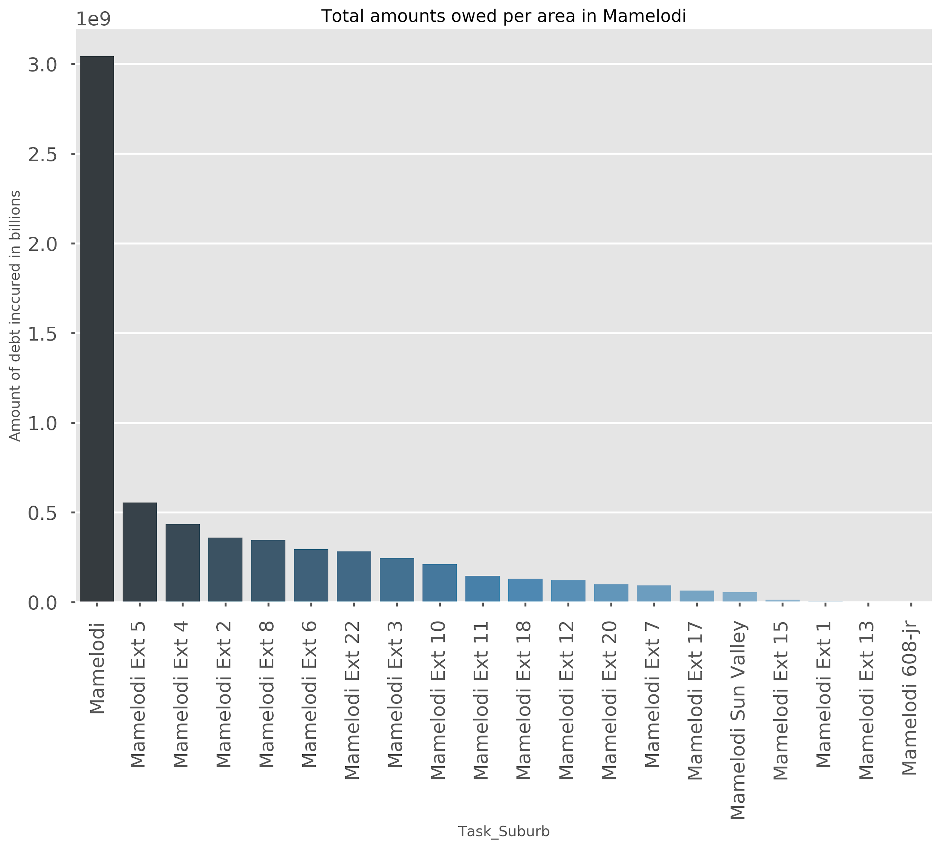

Slide 19
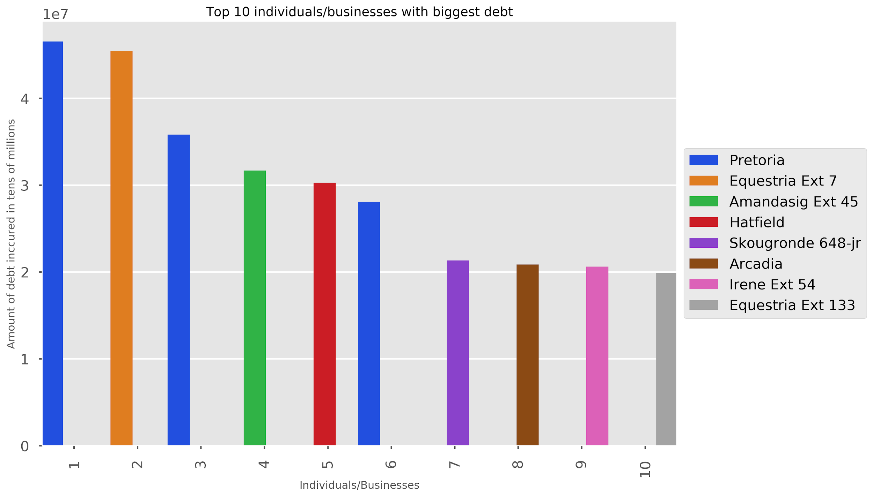

Slide 20
Conclusion
Mamelodi was found to have the most disconnections and so owed the most amount of money
The individual who owed the most was from Pretoria CBD
Moving forward approach on why people are disconnected
How long it takes a person to pay once they have been disconnected

